Slide 1
Lab X2 – Flow Measurement
How is fluid flow measured?

Slide 2
The need to measure fluid flow is universal.
The choice of fluid meter varies, depending on many factors.
“Flow” means quantity/time – m³ /sec, gpm, etc., as distinct from pressure or temperature.
There are many types and variations of flow meter.
We will look at some of the most common ones.
Textbook, Section 6.12, is a good reference.

Slide 3
Lab X2 will look specifically at:
Orifice meter
Venturi
Variable area (rotameter)
Others types include:
Turbine meter (also very common) – demo in lab
Laser anemometer
Hot wire/hot film anemometer
Pitot tube
The last three, and variations, are primarily research tools.

Slide 4
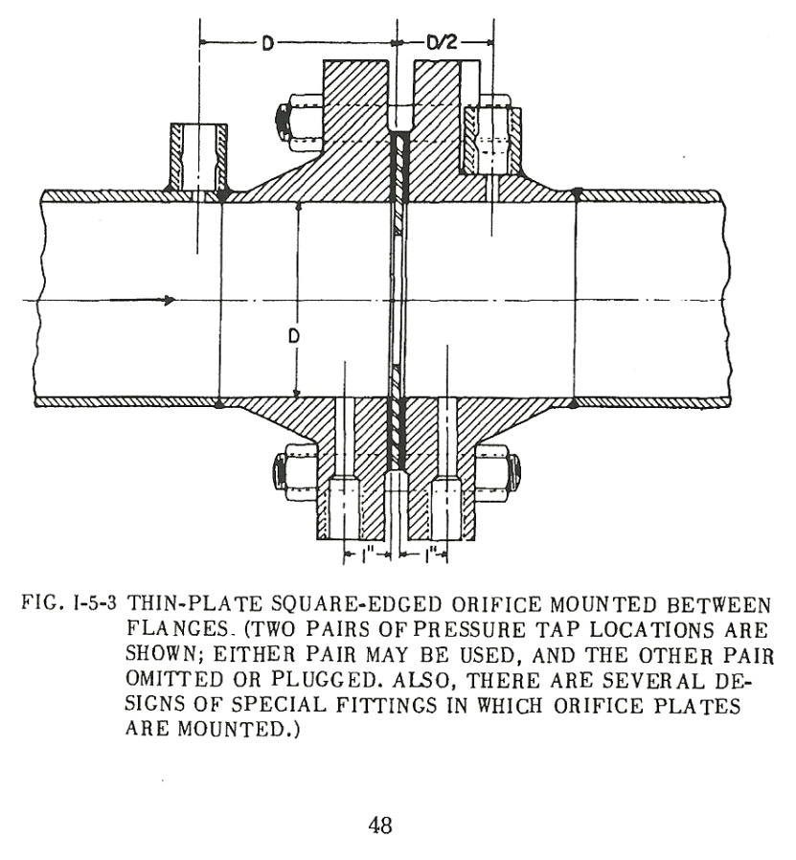
Orifice meter:
Simplest, cheapest (make your own)
Big ΔP in line
May cavitate with liquids
Compressible effects with gases at higher flows
From ASME “Fluid Meters” , 6th ed.

Slide 5
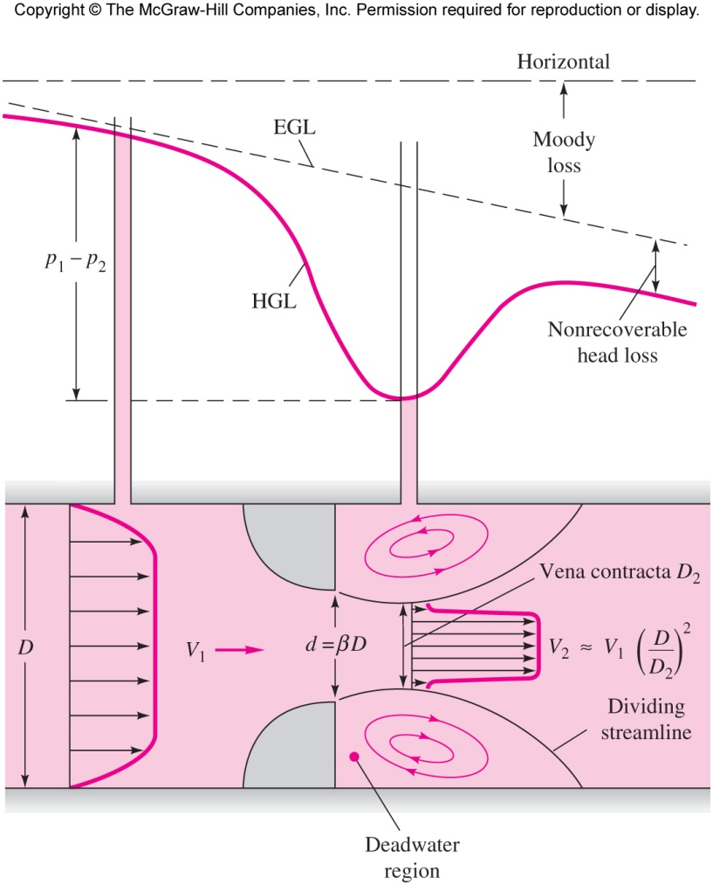
Illustration of ΔP for flow measurement and the
permanent pressure loss in a flow meter
Given C_{d} ,d/D and measuring ΔP, flow Q is calculated.
C _{d} is a correction factor.

Slide 6
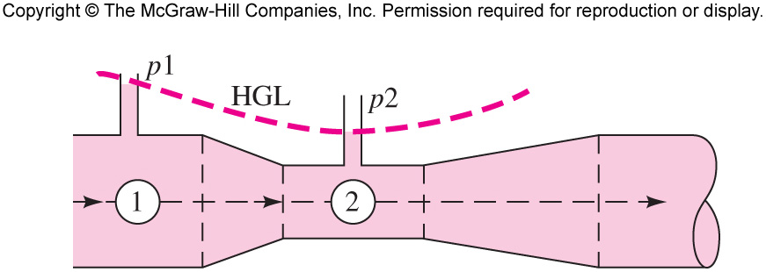
Venturi Meter (Figure from Example 3.15)
Smallest ΔP loss in pipe line
Smaller signal
No cavitation (liquid)
At high gas flows- compressible effects

Slide 7
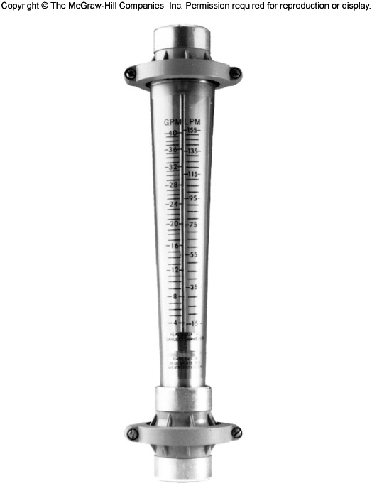
Taper is carefully calculated.
Specific to fluid.
Rotameter:
Simple, but relatively expensive.
Specific to fluid, liquid or gas
Wide flow range possible
May be pressure limited.
May have electronic readout instead of visual ($)

Slide 8
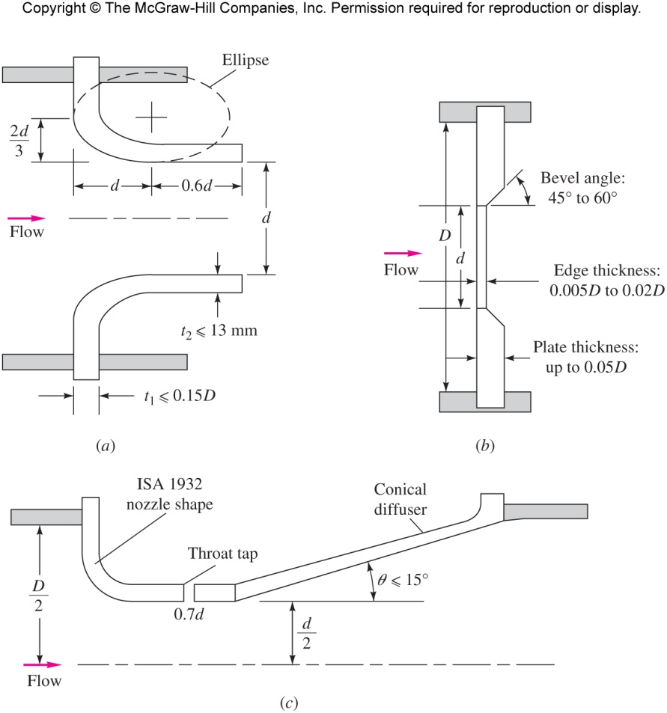
These types of meters have a long history.
Standardized dimensions are available (ASME).
You can still build your own, and calibrate it.

Slide 9
How do you calibrate?
Time tested bucket and stop watch for liquids
(if not hazardous)
Gases? Not as easy. Comparison with calibrated
flow meter in series.
Example: +/- 1 sec timing error:
Small bucket- fill in 10 sec -> +/- 10%
Big drum (30 gal) - fill in 200 sec -> 0.5 %

Slide 10
Other flow meters:
Turbine meter- spinning wheel or propeller inside pipe. Count rpm electronically
Expensive, but widely used.
Moving parts exposed to fluid
Very accurate when calibrated to fluid.
Low pressure loss
Vortex meter – frequency of vortices from a cylinder in the flow is proportional to velocity.
Moving parts not exposed to fluid
Range can be limiting

Slide 11
Measurements based on velocity:
Pitot tube
Cheap, but sensitive.
Measures point velocities
Calibrate to interpret as total flow
Laser Anemometer
Expensive
Requires window into flow
Does not interfere with flow
Generally, a research tool
Hot wire or hot film anemometer
Expensive
Fragile
Measures point velocities
Generally, a research tool

Slide 12
OTHER FACTORS TO CONSIDER:
System pressure
System Temperature (density varies)
Corrosive fluid (long term damage)
Location in process (for servicing, reading, replacement)

Slide 13
Lab X2: Venturi, Rotometer, and Orifice
Lined up in series, so we can compare readings directly
Measure pressure difference and relate to flow (venturi, orifice)
Measure permanent pressure loss of each and compare.

Slide 14
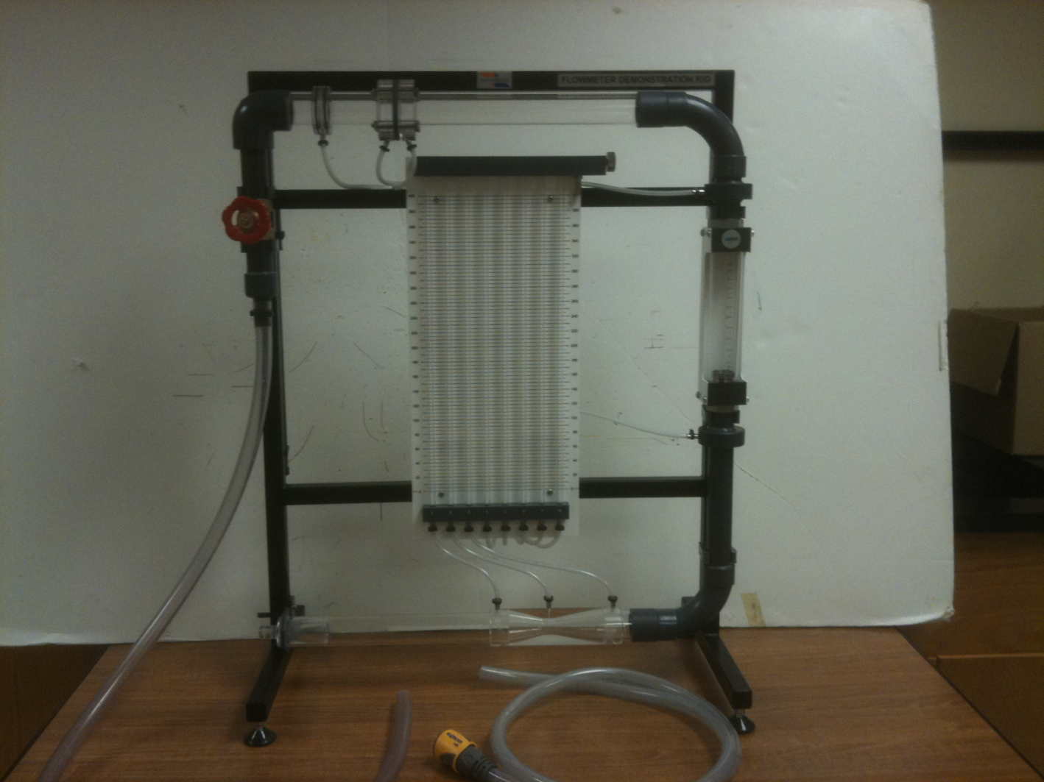
Orifice
Manometer
bank
Rotometer
Venturi

Slide 15
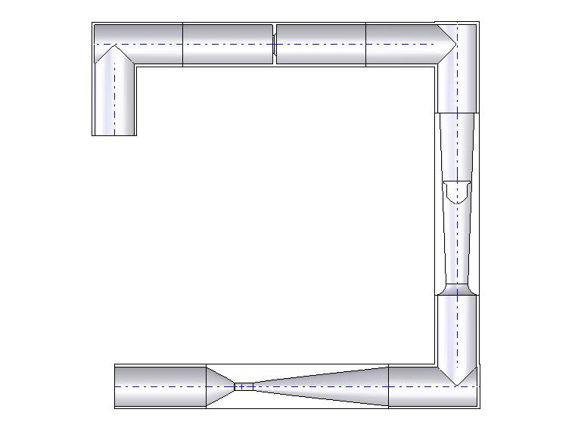
P7
P6
P8
P5
P1 – P2 Venturi
P1 - P3 Venturi loss
P4 - P5 Rotometer loss
P6 – P7 Orifice
P6 – P8 Orifice loss
P4
P1
P2
P3

Slide 16
Design Objective:
Given an industrial unit operation called a thermosyphon reboiler, specify the type or types of flow meters that could be
appropriate. Explain why.

Slide 17
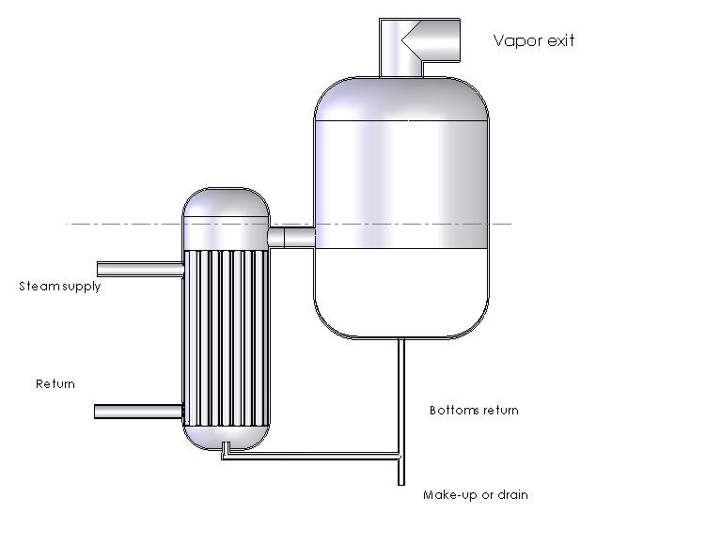
Thermosyphon Reboiler Dimensions
12 ft Diam
6 ft Diam
12 ft
90 psia Sat steam
4 ft
H TBD
Condensed liq

Slide 18
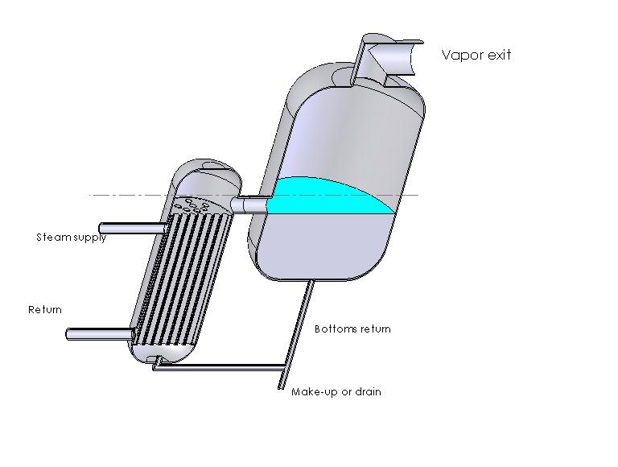
Thermosyphon Reboiler Example

Slide 20
Error Analysis of the Experimental Data
It’s not a Pain, but a Principle!
Why are we doing this?

Slide 21
Measured
True or Theoretical Value
Surely your data points will fall right on the 45º line!
If they do not, your uncertainty analysis should point
to possible reasons why.

Slide 22
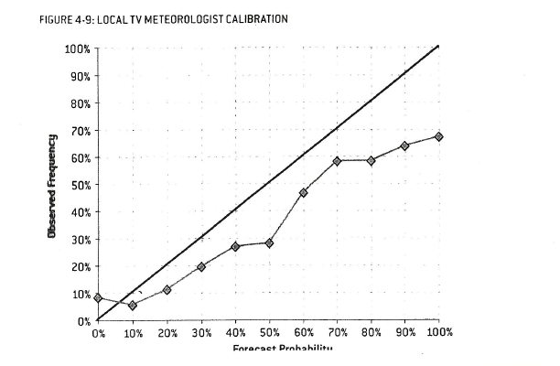
Forecast Rainfall Probability
Ref. “The Signal and the Noise”, Nate Silver, 2012, Penquin Press

Slide 23
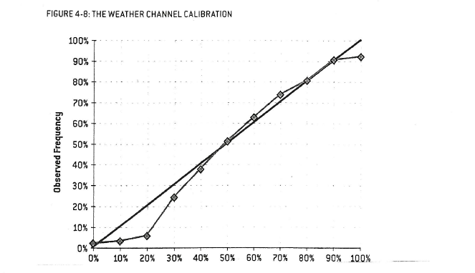
Forecast Rainfall Probablility
Ref. “The Signal and the Noise”, Nate Silver, 2012, Penquin Press

Slide 24
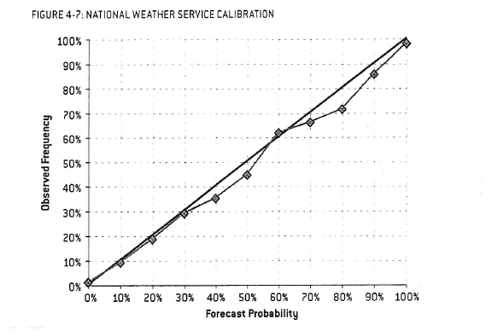
Ref. “The Signal and the Noise”, Nate Silver, 2012, Penquin Press

Slide 25
Lab X1 Error analysis asks for one chart:
Moment
of pressure
force
Calculated Moment
Does your data fall on the 45-degree line? ….
Explain why not (If it doesn’t)

